Slide 1
Indy-4-Kitchen
CS4850-02 Spring 2024
4/8/24
Merrick, Nick, and Minchul

Slide 2
Delegation of Tasks
Nick: Backend Developer
Server, API Architecture and Database.
Minchul: Frontend Developer
HTML, CSS, ReactJS, Frontend Design.
Merrick: Documenter
Team Organizer, Documenter Writer, Design Coordinator.

Slide 3



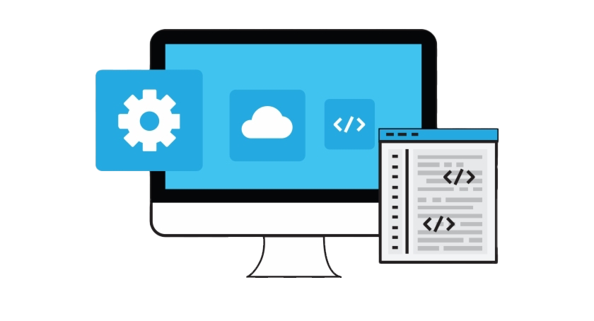
Project Goal
Our goal is to connect people who run ghost kitchens (kitchens that are setup for delivery only meals) to people wanting cooked meals.
Accomplishing this goal is through a platform web service that we call MyKitchen.

Slide 4




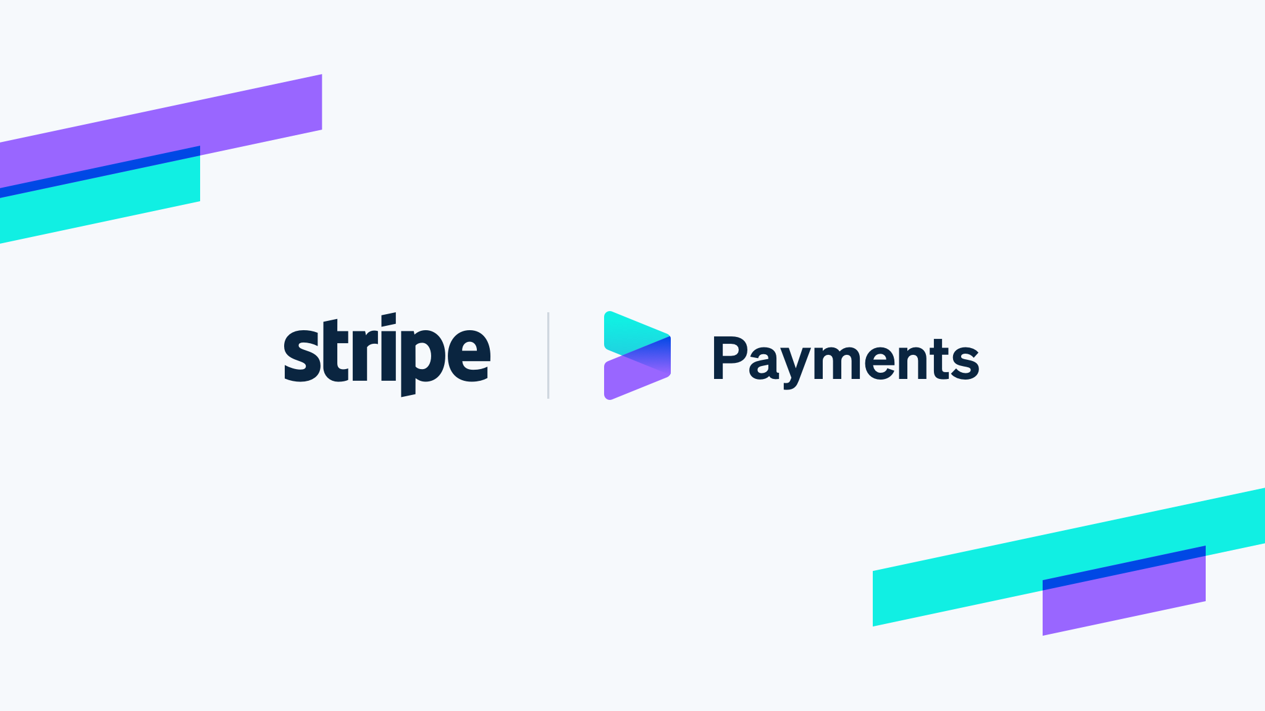

Tech Stack
ColoBlox Atlanta – Datacenter
SuperMicro Server with Windows Server 2019
PHP – Backend Programming Language
MySQL – Database
ReactJS – Frontend Programming Framework
Stripe – Payment Service

Slide 5
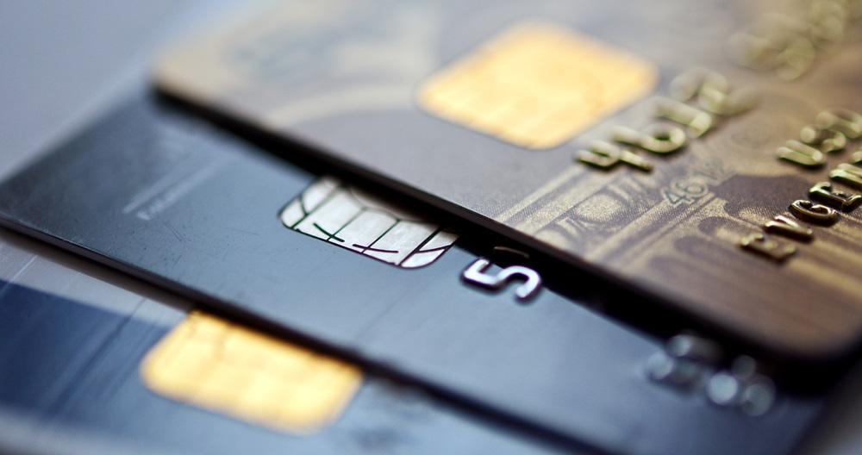

Why Stripe
Payment bridge from User to Kitchen
PayPal requires unnecessary effort on Kitchen setup- New Best friend stripe
Notes:
Stripe was the easiest integration with the most features. Subscription, and universal card access. Some cards allowed for paypal.
They allow you to charge all cards accepted in all of America and most parts of Europe, and have the ability to do subscription payments.

Slide 6

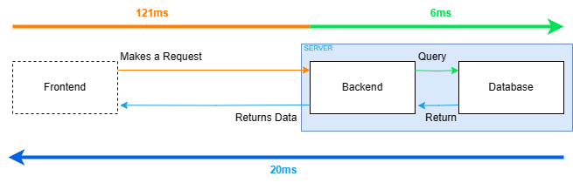
On-Prem > Cloud
Datacenter in Truist Park
Cost
Reduce microservices
Notes:
The cost of a Windows server with a 32-core Intel CPU, 64GB RAM, and 1TB of storage is $1198.08/month in Azure Cloud.
This server is only

Slide 7
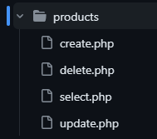
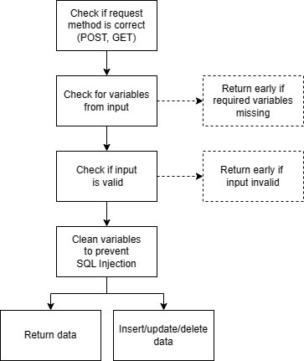
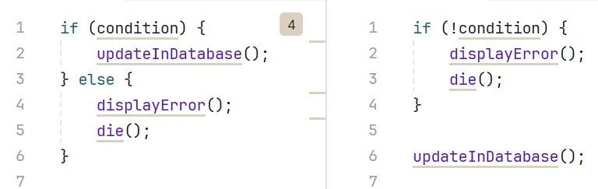
Backend Server Architecture
REST API (/handle/function structure)
28 endpoints for CRUD
Early Returns in php
Notes:
When PHP is run as a specific windows user, you can delegate exactly what it's allowed to do in your database.
This makes php injections less likely and SQL takeover impossible.

Slide 8
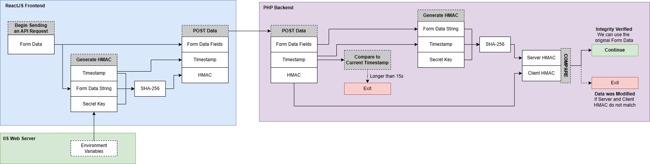
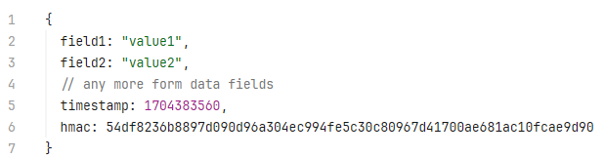
API Security
Access-Control-Allow-Origin Header
HMAC Hash-Based Message Authentication Code
FormData Cleansed to stop SQL Injection

Slide 9
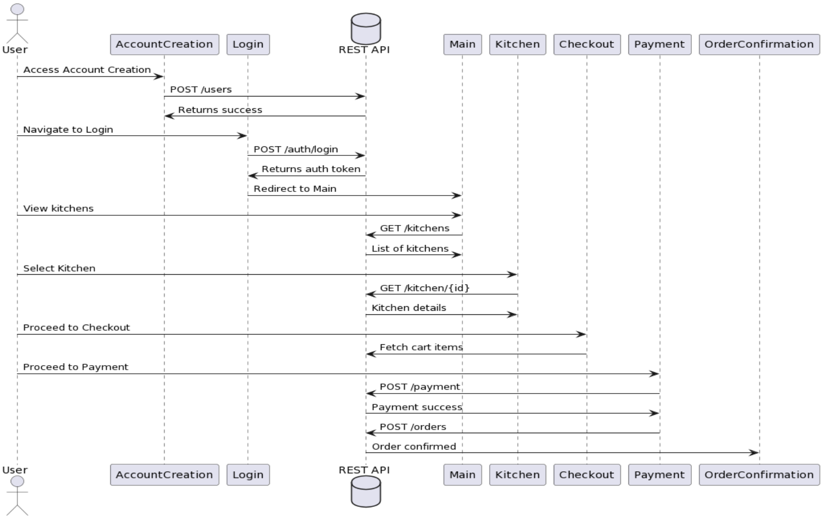
Web Sequence Diagram

Slide 10
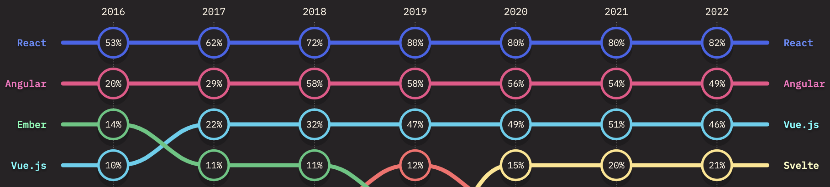
ReactJS Wins!
*Preferred JavaScript framework

Slide 11
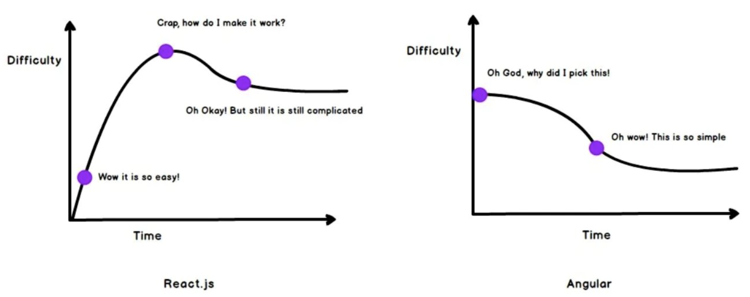

ReactJS
Source: https://www.linkedin.com/pulse/most-popular-libraries-react-vindevs-n5m9f
Source: https://medium.com/@kanth.vallampati/9063dc742902

Slide 12
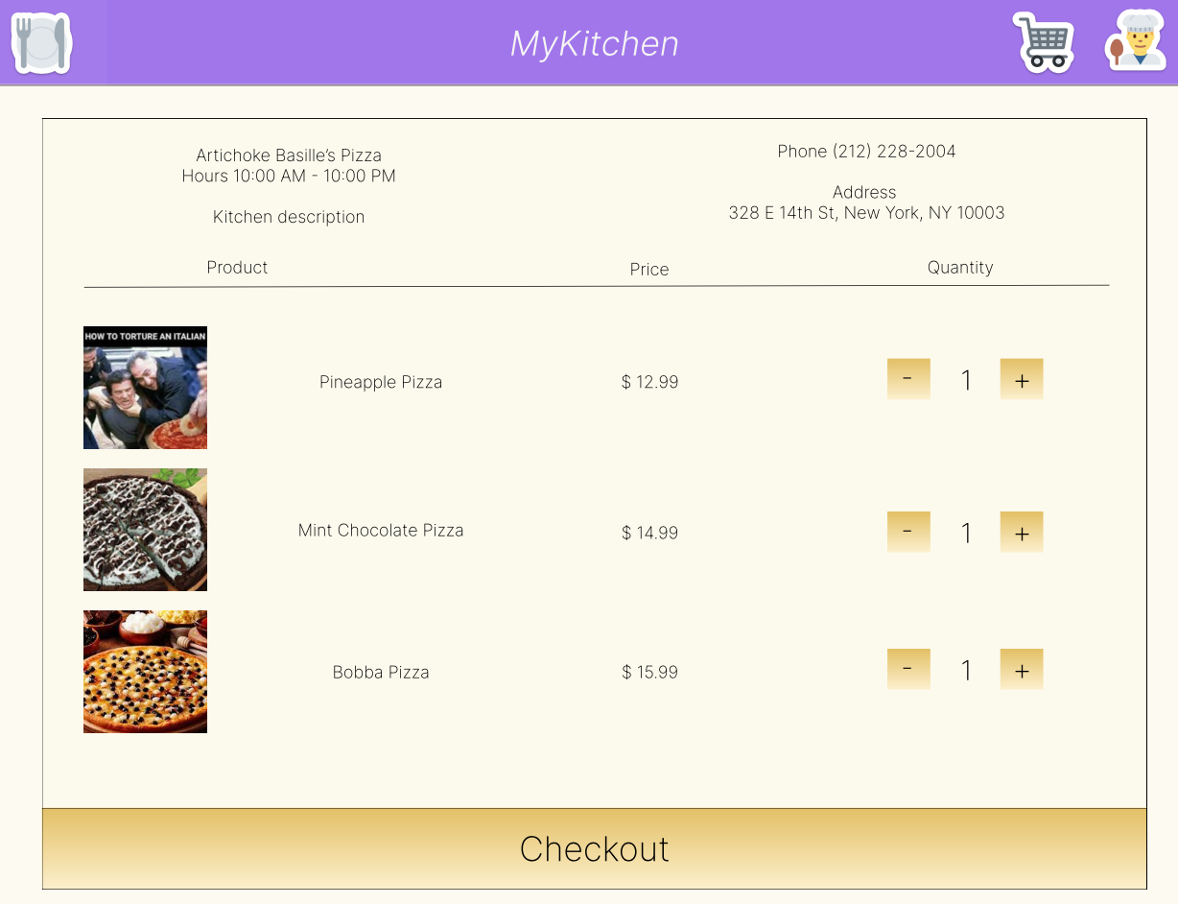


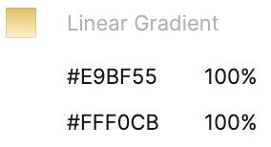
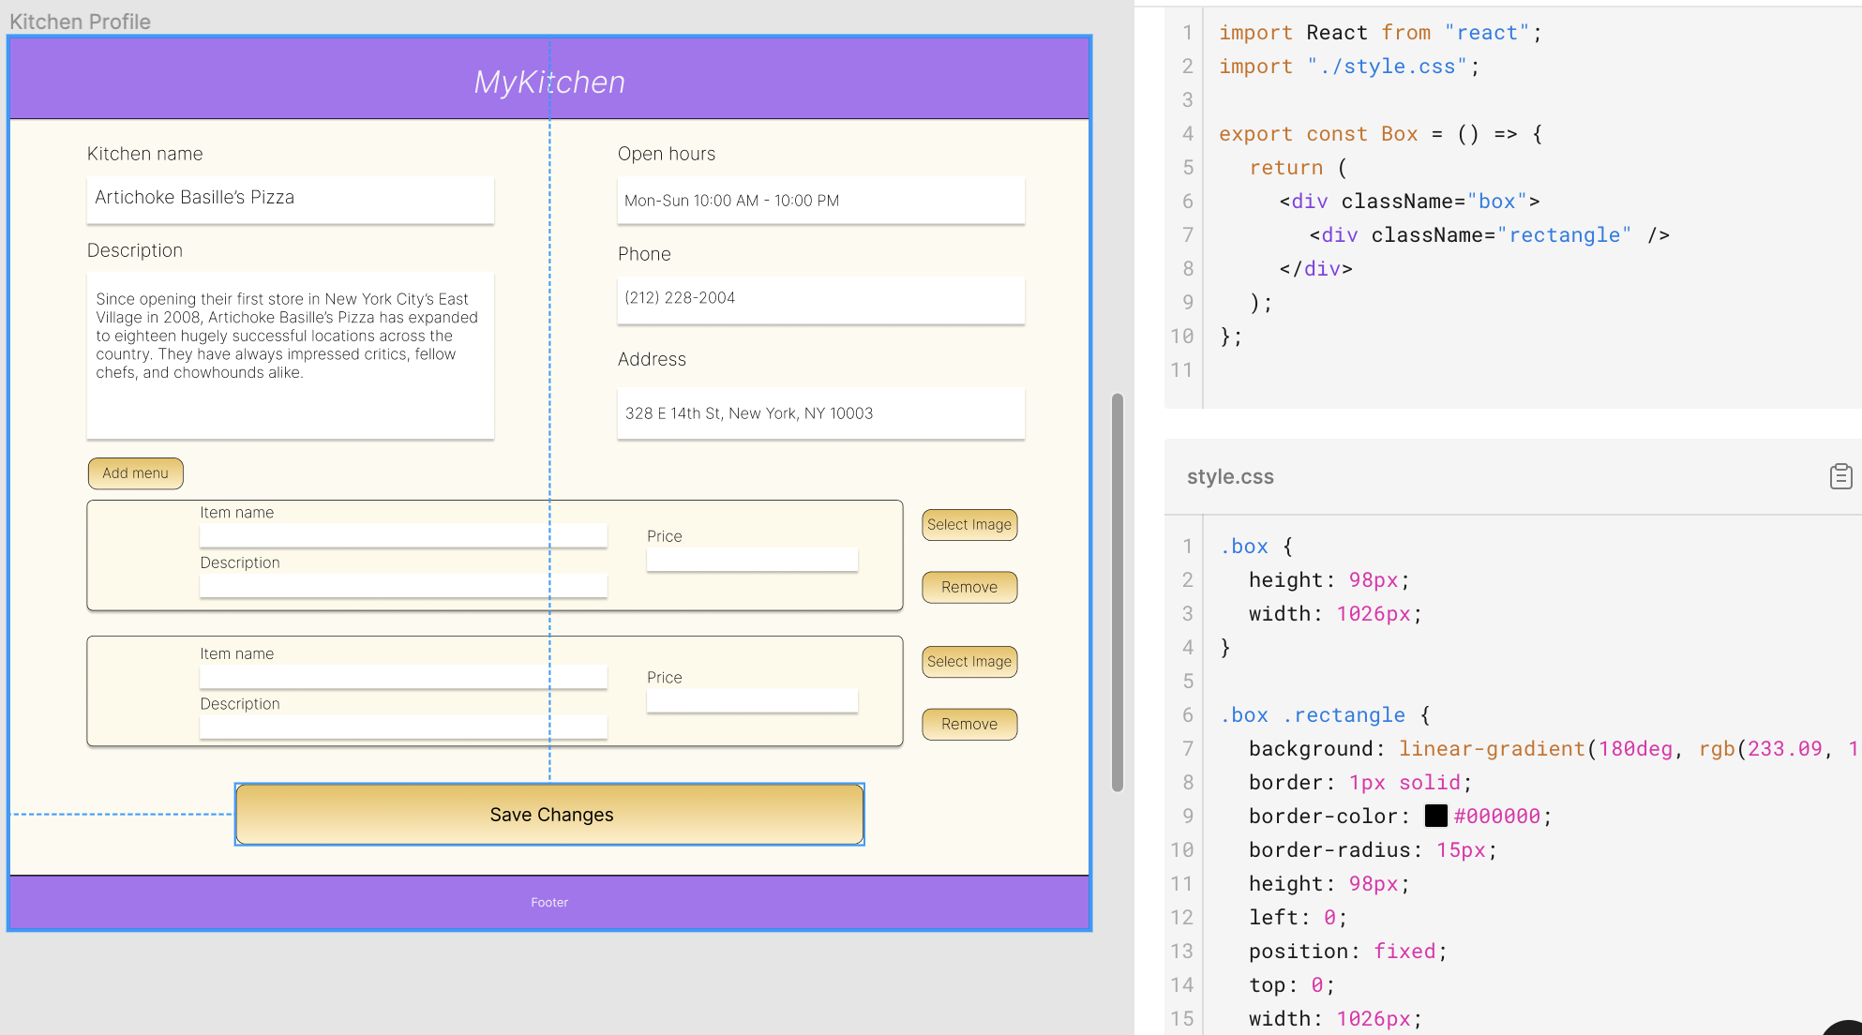
Figma Dev Mode
Free to use with student email
UI design can be exported as code for React, html, as well as Android / IOS

Slide 13

Demo

Slide 14
Future Plans
Inclusion of traditional restaurants
Further testing of UI

